Slide 1
Object Oriented Programming Lab
CSE 1206

Slide 2
Jdk and NetBeans download link
http://www.oracle.com/technetwork/java/javase/downloads/jdk8-downloads-2133151.html
https://netbeans.org/downloads/
https://www.youtube.com/watch?v=pgr-Bzkc4zg

Slide 3
Sample Java program
public class Hello {
public static void main(String[] args) {
System.out.println("Hello Java");
}
}

Slide 4
Run from CMD
Type in the command prompt window.
cd.. [cd stands for change directory].
pushd address of the path [ pushd stands for push directory, used to push the path where java file has been saved]
set path=“C:\Program Files\Java\jdk1.8.0_77\bin”
javac Hello.java
java Hello

Slide 5
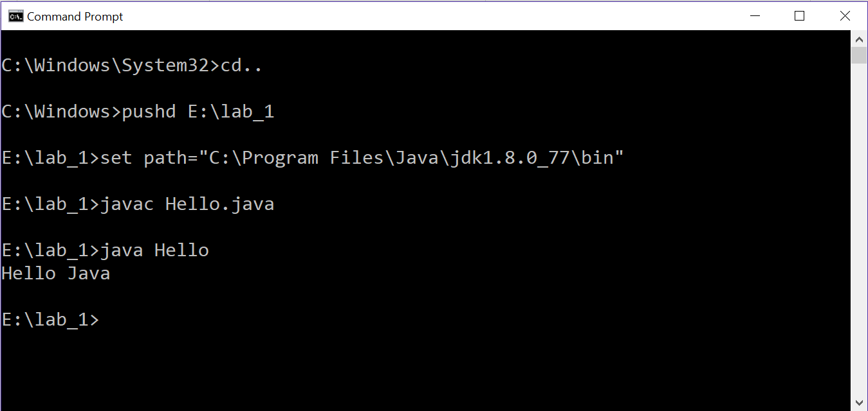

Slide 6
Run from NetBeans

Slide 7
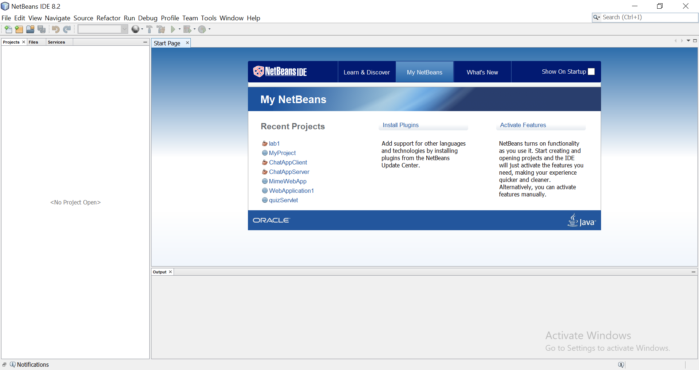

Slide 8
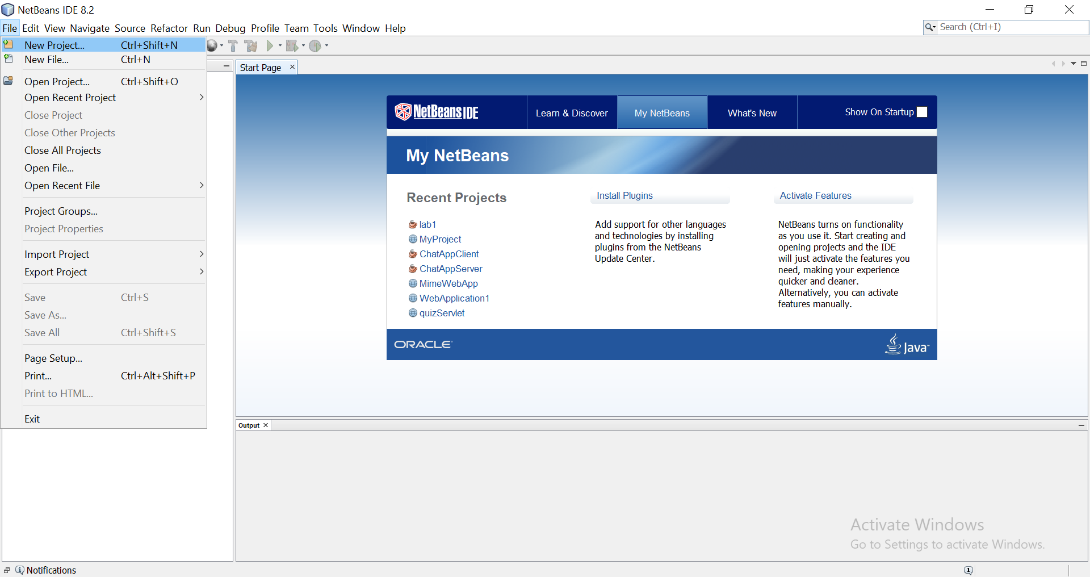

Slide 9
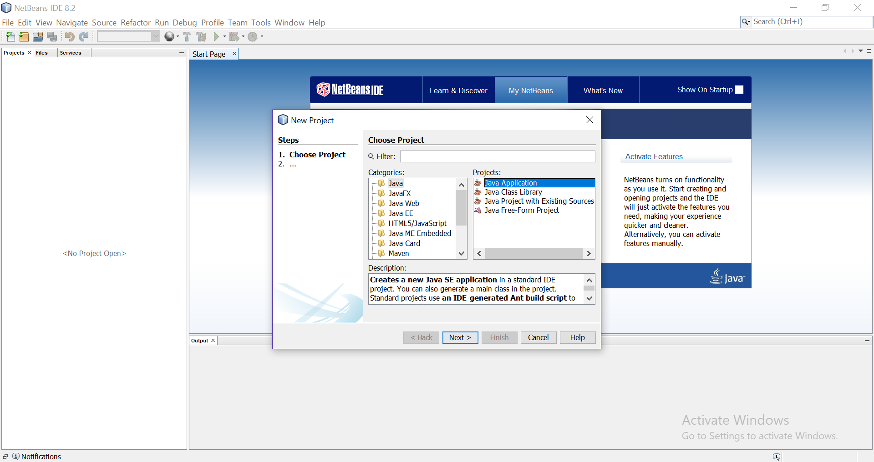

Slide 10
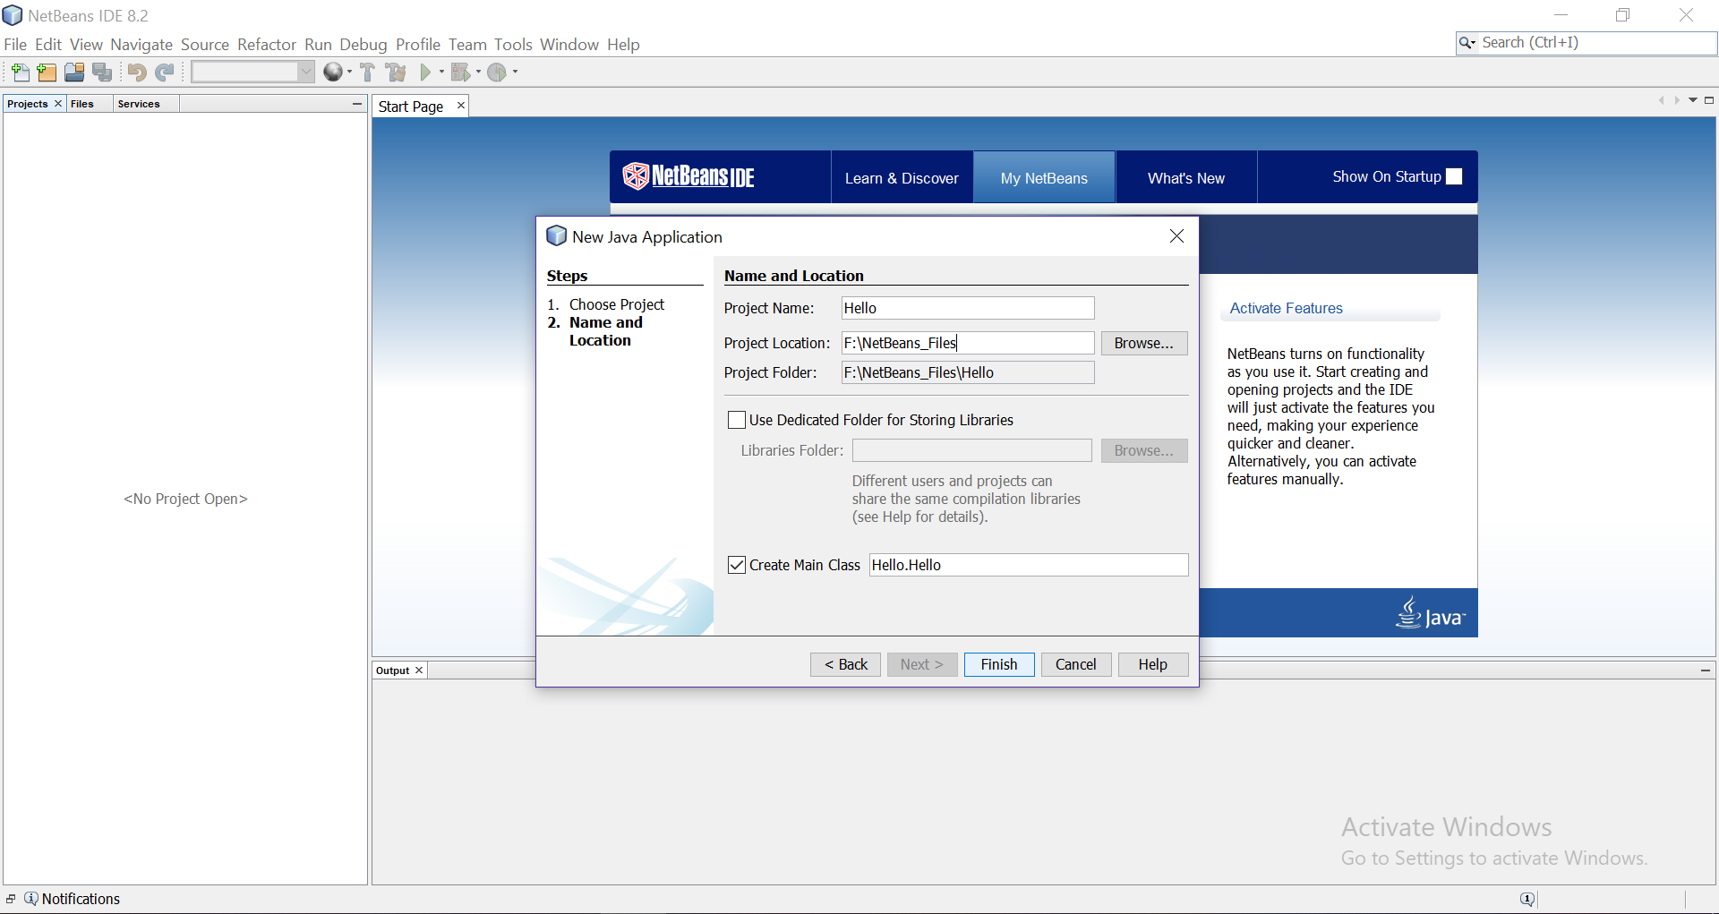

Slide 11
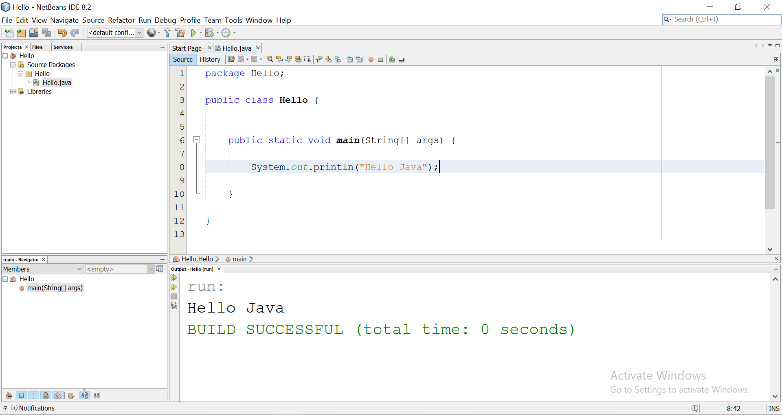

Slide 12
Basic Java Syntax
https://www.w3schools.com/java/java_syntax.asp

